Slide 1
Go with the Flow!
Fluid Dynamics
Class 1: Intro to Differential Equations
Instructor: Sarah Patterson

Slide 2
Welcome
Welcome to “Go with the Flow!” at the Duke Summer Workshop in Mathematics (SWiM)!
Please grab a sheet of construction paper and create a name tent.

Slide 3
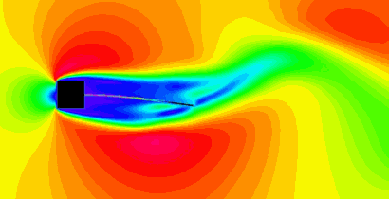
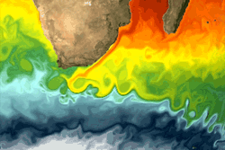
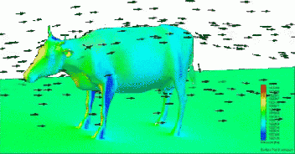
Computational Fluid Dynamics

Slide 4
Introduction to Modeling
Mathematical modeling is the application of mathematical and statistical methods to analyze complex, real-world problems in order to make predictions about what might happen with various actions.

Slide 5
Introduction to Modeling
In a continuous model, time changes continuously, while in a discrete model, time changes in incremental steps.
Can you think of examples of continuous or discrete models?

Slide 6
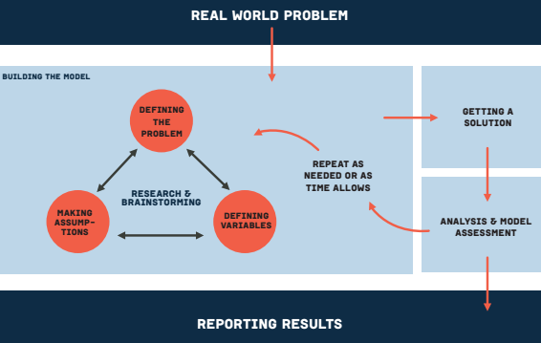
The Modeling Process

Slide 7
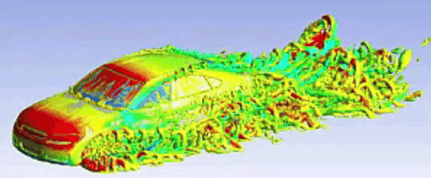
Average Speed
A car traveled 50 miles after one hour and 190 miles after three hours. What is the average speed of a car between hours one and three?

Slide 8
Average Speed
The average speed is given by
(190 mi - 50 mi)/(3 h - 1 h) = 140 mi/2 h = 70 mph.

Slide 9
Average Speed
In general, average speed is given by the change in position divided by the change in time. This is often denoted as 𝛥s/𝛥t.

Slide 10
Average Rate of Change
More generally, the average rate of change of y with respect to x is given by the change in y divided by the change in x. This is often denoted as 𝛥y/𝛥x. Geometrically, this can be interpreted as slope.
Notes:
Draw function and label slope.

Slide 11
Average Speed
Would the car always be traveling this speed? If not, how could we get a more accurate measure of speed?

Slide 12
Average Speed
Would the car always be traveling this speed? If not, how could we get a more accurate measure of speed?
By taking smaller and smaller intervals of time, we could get could very close to the actual speed of the car at a given point in time.

Slide 13
Instantaneous Rate of Change
The instantaneous rate of change of y with respect to x is the value that the average rate of change, 𝛥y/𝛥x, approaches as the change in x approaches 0.

Slide 14
The Derivative
Another name for the instantaneous rate of change is the derivative. We often denote the derivative of y with respect to x as dy/dx or y’(x).

Slide 15
The Derivative
If y(x) is a function, then dy/dx or y’(x) is the rate of change of y with respect to x.
Ex. Suppose s(t) represents position, then ds/dt or s’(t) would represent speed at time t.
Ex. Suppose P(t) represents population, then dP/dt or P’(t) would represent the rate of change of the population at time t.

Slide 16
Differential Equations
A differential equation is an equation that involves one or more derivatives.
dy/dx=f(y,x)
There are entire fields of mathematics devoted to solving differential equations.

Slide 17
Initial Conditions
An initial condition is the value of the dependent variable for a specific value of the independent variable. We typically denote an initial condition as y(x₀) = y₀.

Slide 18
Solving Differential Equations
A solution to a differential equation is the function that satisfies the equations and initial condition(s).

Slide 19
Solving Differential Equations
Let us begin by considering the differential equation dy/dx = 2, with the initial condition y(0) = 3. What function satisfies this differential equation?

Slide 20
Solving Differential Equations
Let us begin by considering the differential equation dy/dx = 2, with the initial condition y(0) = 3. What function satisfies this differential equation?
We are looking for a function such that the rate of change is always equal to 2 and the value of y is 3 when the value of x is 0.

Slide 21
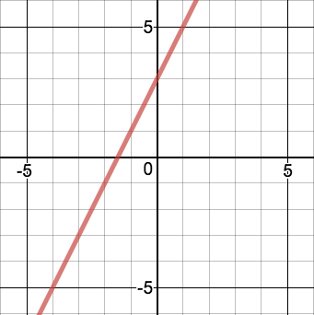
Solving Differential Equations
y = 2x + 3

Slide 22
Solving Differential Equations
In general, the solution to the differential equation dy/dx = a, with the initial condition y(0) = b is given by y = ax + b.

Slide 23
Solving Differential Equations
Consider the differential equation
dP/dt = rP,
where P(t) is the population at time t, r is the growth rate, and P(t₀) = P₀ is the initial condition.
The rate of change of the population is proportional to the population.
Notes:
This differential equation can be solved exactly using techniques from calculus, but we will find an approximation of the solution.

Slide 24
Finite Difference Approximation
We can use a finite difference to find an approximate solution.

Slide 25
Go with the Flow!
Fluid Dynamics
Class 2: Systems of Differential Equations

Slide 26
Unconstrained Model
What are the limitations to the unconstrained model we discussed yesterday?

Slide 27
Unconstrained Model
The unconstrained model assumes that a population could continue to grow to an infinite size.
We know, however, this is not possible due to limited resources.
To account for this, we will develop a constrained growth model, where the population can only reach a finite number.

Slide 28
Carrying Capacity
The carrying capacity for an organism in an area is the maximum number of organisms that the area can support.
What factors might influence the carrying capacity?

Slide 29
Revised Model
How can we revise our model to account for the carrying capacity?

Slide 30
Death Rate
We must include a term that represents the death rate of the population.
This death rate should be close to zero when the population is small and close to the birth rate when the population is large.
What will this term look like?

Slide 31
Death Rate
The death rate is given by
dD/dt = (P/M)rP,
where M is the carrying capacity of the population.
Note that when P is small, the death rate is close to 0 and when P is close to M, the death rate is close to the birth rate dB/dt = rP.

Slide 32
Logistic Equation
Our new model then states that the change in the population is given by the difference between the birth rate and the death rate, or
dP/dt = rP - (P/M)rP = r(1 - P/M)P.
This is called the logistic equation.

Slide 33
Logistic Equation
Consider a group of mammals with an initial population of 20, carrying capacity of 1000, and a birth rate of 0.5. What is the rate of change of the population?

Slide 34
Logistic Equation
Consider a group of mammals with an initial population of 20, carrying capacity of 1000, and a birth rate of 0.5. What is the rate of change of the population?
dP/dt = 0.5(1 - P/1000)P

Slide 35
Spreadsheets
Using a Google Sheets, find and graph approximate values of the population over time.

Slide 36
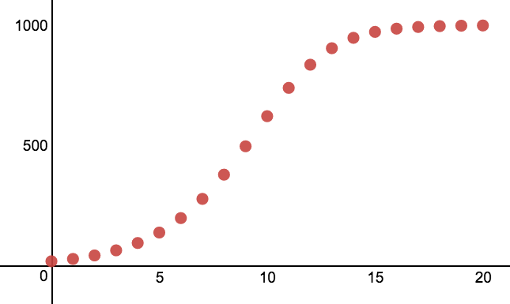
Logistic Equation

Slide 37
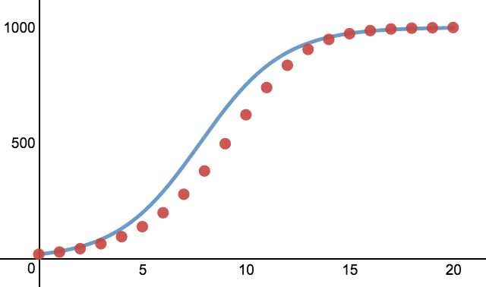
Logistic Equation
Using calculus, we can find the exact solution.

Slide 38
Behavior of the System with Different Initial Conditions
What would happen if the initial population was larger than the carrying capacity?
What if the initial population was equal to the carrying capacity?

Slide 39
Stability and Equilibrium Solutions
The carrying capacity is an equilibrium solution.
An equilibrium solution is a constant function y(t) = c that solves the IVP.
An equilibrium solution is called stable if all nearby solution approach that value at time gets large. Otherwise the equilibrium solution is called unstable.

Slide 40
Stability and Equilibrium Solutions
Do the following differential equations have equilibrium values? What is their stability?
dy/dt = y
dy/dt = t
dy/dt = tsin(y)
dy/dt = ysin(t)

Slide 41
Rumor Spreading
Let’s model rumor spreading using differential equations. We have two populations to consider, the spreaders, S(t), and the ignorants, I(t).
How can we represent the rate of change of each of the populations?

Slide 42
Rumor Spreading
An ignorant person becomes a spreader by having contact with the spreader. What is the number of possible contacts?

Slide 43
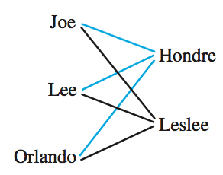
Rumor Spreading
The number of possible contacts is the product of the sizes of the population of spreaders and ignorants, SI.

Slide 44
Rumor Spreading
The rate of change of the number of spreaders will grow as the rate of change of the number of ignorants will decrease. Let’s define r to be the rumor spreading rate. Then we will have the following two differential equations.

Slide 45
Rumor Spreading
dS/dt = rSI
dI/dt = -rSI

Slide 46
System of Differential Equations
In order to model rumor spreading, we will need to solve a system of differential equations. This means we will be solving two differential equations simultaneously.

Slide 47
Rumor Spreading
We will now solve the rumor spreading model numerically using google sheets.
What changes need to be made to our single variable Euler’s method?

Slide 48
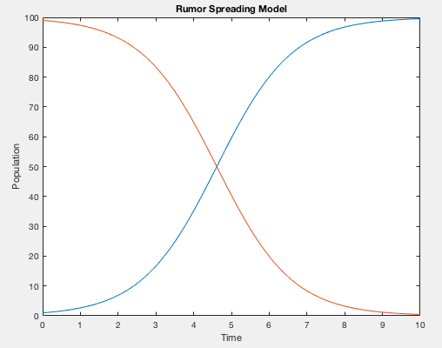
Rumor Spreading

Slide 49
Connection to the Logistic Model
The total population is fixed!
1 = S+I
dS/dt = rSI=rS(1 - S)
dI/dt = -rSI=-rI(1- I)

